Slide 1
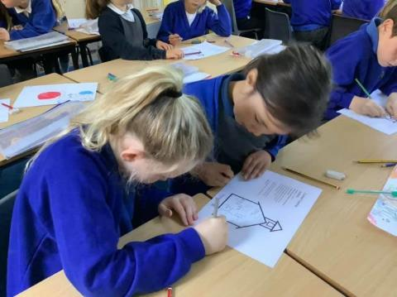
ACTIVITIES 2021
Notes:
Staveley Primary School children engaging in climate change project as part of COP26.

Slide 2
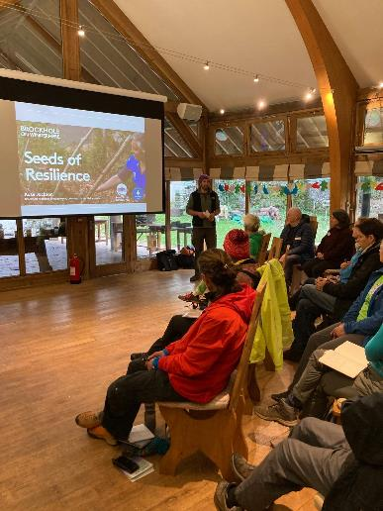
LEADING AND INFLUENCING
Active member of Cumbria Sustainability Network, Cumbria Transport Group, presentations at events about SENS work
Stronger working relations with the Parish Council, and Flood/Sewage Task Force
Responses to consultations: LDNPP Management Plan, CTIP, LCWIPs and planning applications (Danes Road, Crookfields, Alec Row etc.)
Engagement with the Community Plan
Engagement with LDNPA – pilot project discussions

Slide 3
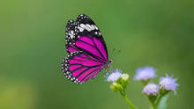
PROGRAMMES LED BY SENS
SENS leading on Biodiversity Actions for Staveley Community Plan Group – currently working with CDEC Green Places Officer to engage youth with green spaces, submitted biodiversity survey (including proposal for community orchard to Parish Council)
Co-ordinating campaign to Clean up the River Kent
Fundraising - £grant for Great Big Green Week, £for water quality testing, Lottery application pending
Notes:
Action Plan linked directly to the actions listed in:
Staveley Community Plan Actions
LDNPP Management Plan
Local conservation group objectives
NB both Action Plan and Biodiversity Plan very simple – 2-3 pages, with outline timetable

Slide 4
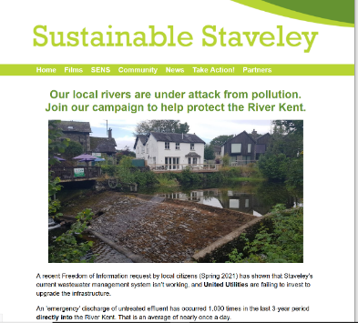
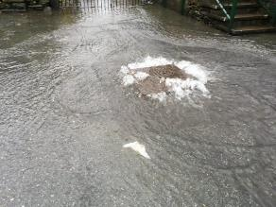
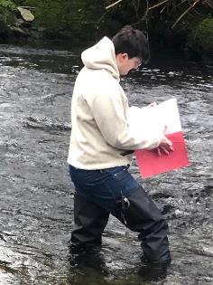
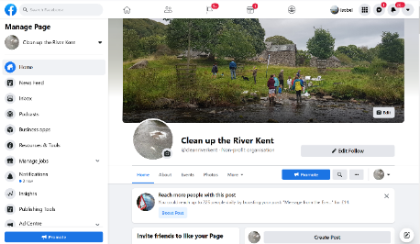
Campaign – Clean up the Kent!
National & local press coverage
Website & Facebook page
Uni of Cumbria student research
Coalition of communities
Fundraising for citizen science water quality testing
Engagement with EA/UU, SCRT, Woodland Trust & other stakeholders

Slide 5
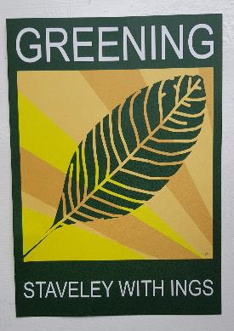
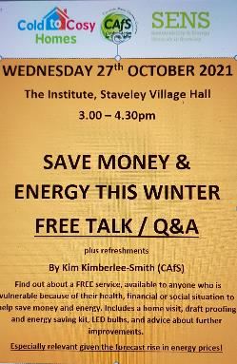
PROJECTS INVOLVED IN
Greening Initiative, Staveley
CAfS Cold-to-Cosy Champions programme
Hydro scheme, Mill Yard – feasibility
4. Charge my Street EV plug in installation, Mill Yard
5. Jack’s Corner – planting, maintenance, noticeboard, litter picking facility (on way!)
Notes:
Action Plan linked directly to the actions listed in:
Staveley Community Plan Actions
LDNPP Management Plan
Local conservation group objectives
NB both Action Plan and Biodiversity Plan very simple – 2-3 pages, with outline timetable

Slide 6
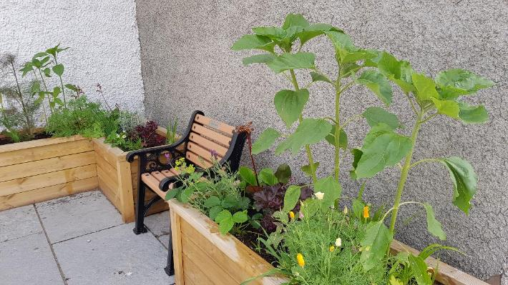
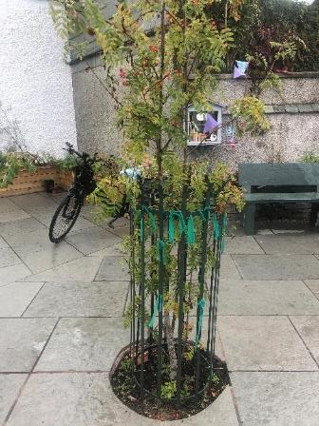
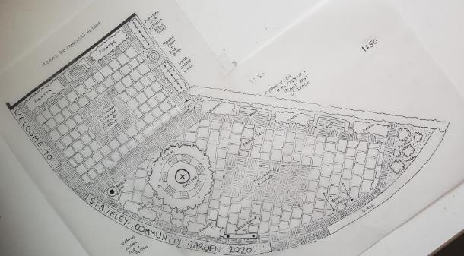
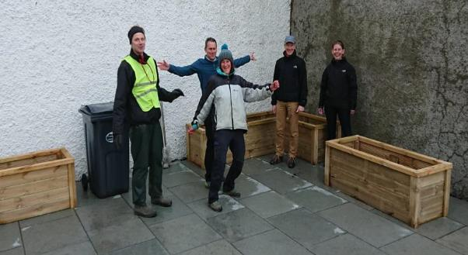
Jack’s Corner – plans and planters
Notes:
Parish Council led on redesign of public space in centre of village.
SENS helped out by creating a plan, based around encouraging biodiversity with plants and features, for community consultation
Design was altered a bit due to budget etc. but still work in progress.
SENS applied for a grant to produce series of planters
Women’s Institute provided the benches

Slide 7
Great Big Green Week 2021 – EVENTS
Notes:
Most recently:
Took advantage of Great Big Green Week 2021 to reach out to other local groups e.g. Womens Institute, etc.
In partnership delivered a series of community events, by the community, for the community
E.g. including led walk to explore our woodlands and showcase the allotments,

Slide 8
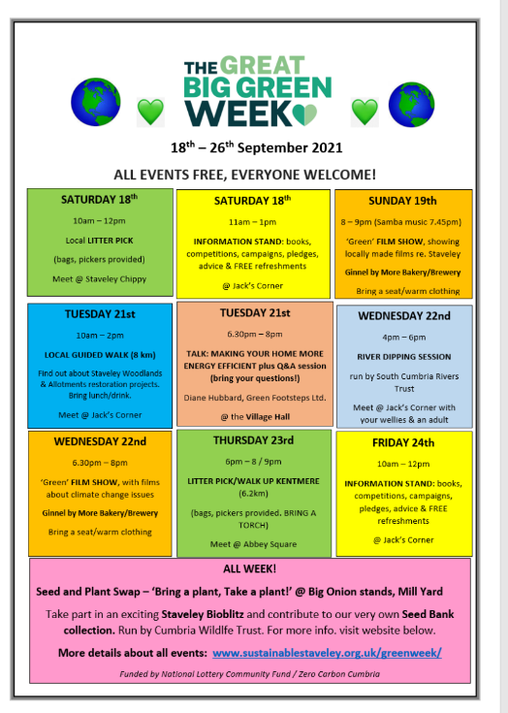
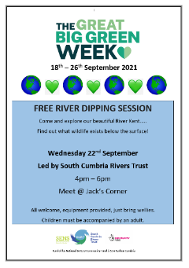

Slide 9
River dipping session as part of Great Big Green Week 2021, organised by South Cumbria Rivers Trust
Notes:
SCRT are up for running more events, talks etc. – good partnership – and events/activities engage and speak to community

Slide 10
Information stand about Staveley Seed Bank project & Bio-Blitz, organised by Cumbria Wildlife Trust
Notes:
Great Big Green Week launched these on-going events for Staveley – opportunity to refer back to them through year

Slide 11
Seed and Plant Swap, organised by The Big Onion Community Stall
Notes:
Engaged other local groups

Slide 12
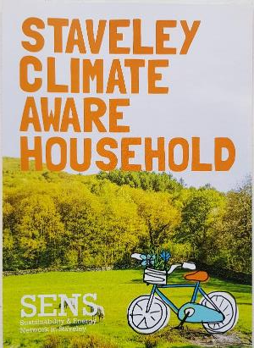
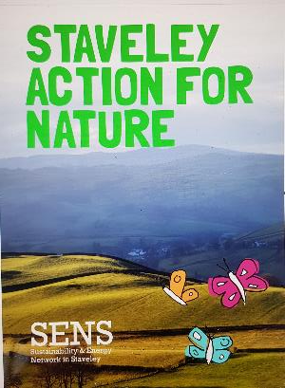
COMMUNICATIONS / ENGAGEMENT
Monthly newsletters and case studies
Greater social media presence (and engagement)
Engagement/partnerships with more audiences
(e.g. school, WI, Big Onion, Lakes School, other
environmental groups in Cumbria)
4. Nature and Climate Household leaflets distributed
(inc. competitions)

Slide 13
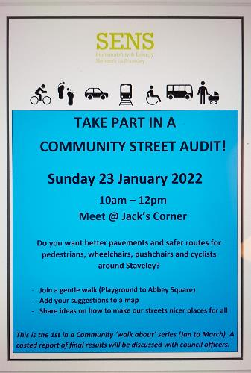
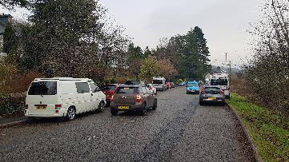
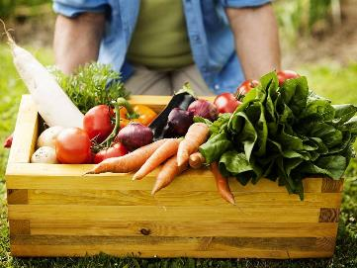
SENS 2022 - Existing commitments
Clean up the River Kent campaign
Community Street Audits
CDEC Green Space project
Notes:
Action Plan linked directly to the actions listed in:
Staveley Community Plan Actions
LDNPP Management Plan
Local conservation group objectives
NB both Action Plan and Biodiversity Plan very simple – 2-3 pages, with outline timetable

Slide 14
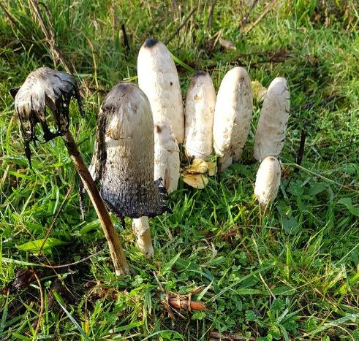
SENS priorities – 2022?
Review:
SENS Action Plan (2021 – 23) covering: Biodiversity, Home Energy, Active Travel, Local Growing & Farming, Flood Management, Renewable Energy, Communications, Partnerships
SENS Biodiversity Plan (2021-23) expanding on the headlines in SENS Action Plan.
Notes:
Action Plan linked directly to the actions listed in:
Staveley Community Plan Actions
LDNPP Management Plan
Local conservation group objectives
NB both Action Plan and Biodiversity Plan very simple – 2-3 pages, with outline timetable

Slide 15
SENS priorities – 2022?
More practical events – annual calendar of activities e.g. tree planting, river dipping, litter picks ?
More social media/newsletters / press work?
More local growing projects?
More engagement with local businesses?
More funding applications?
Another Great Big Green Week?
More campaigning on Cumbria, national issues?
More partnerships / joint projects?
Community ebike project?

